Slide 1
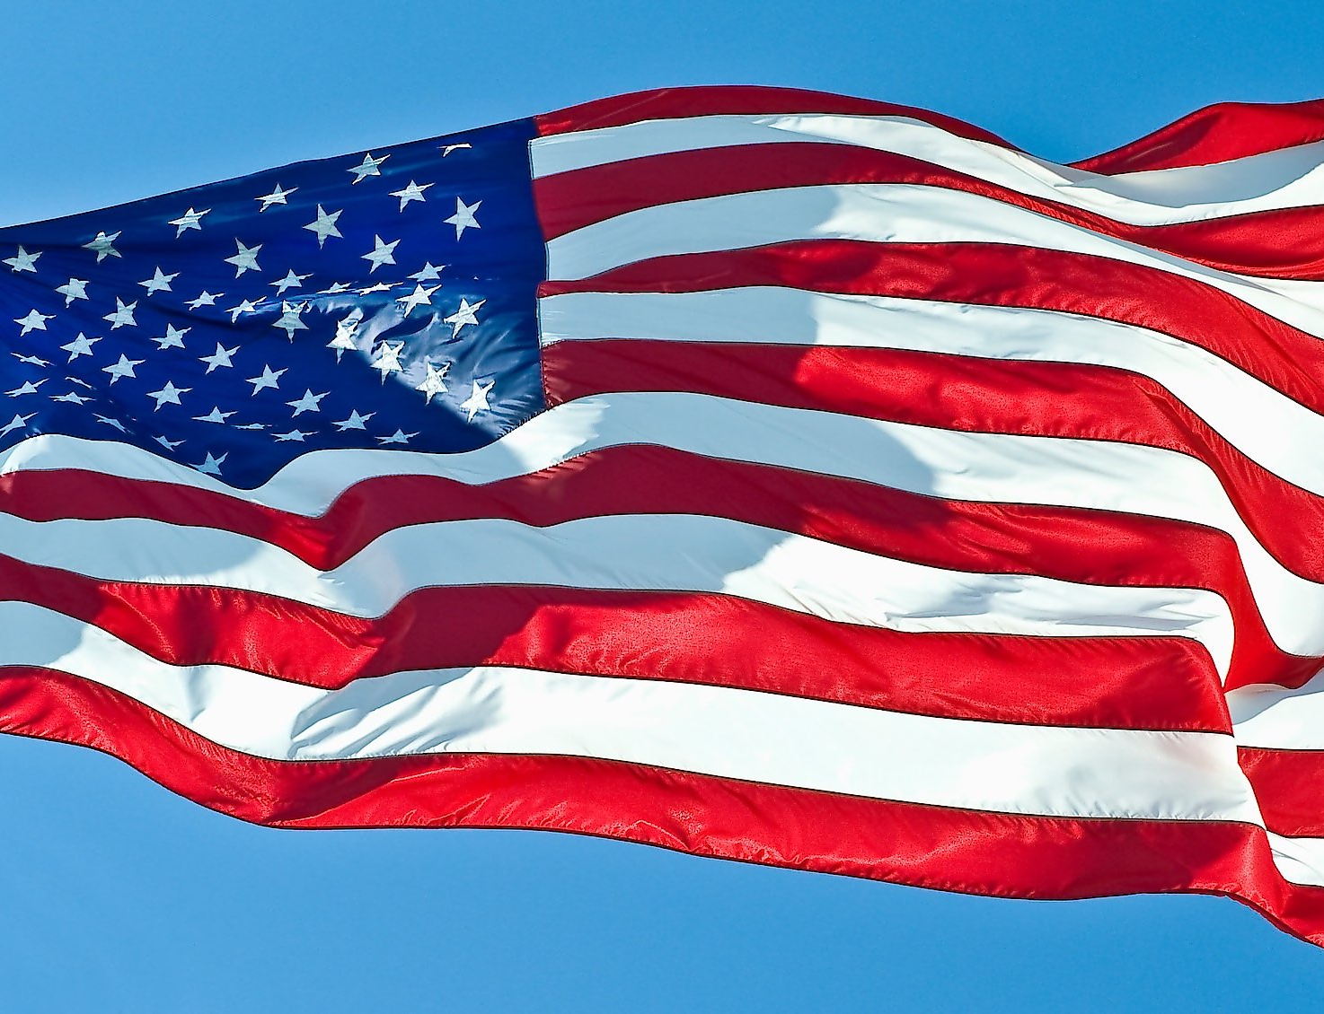

MA AMERICAN STUDIES

Slide 2
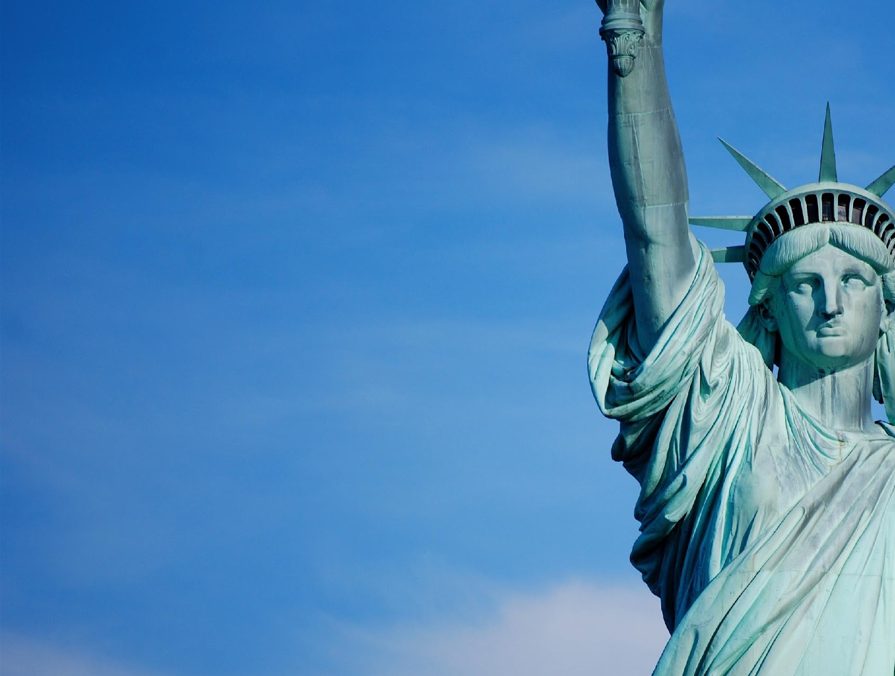
AMERICAN
STUDIES
Dr. Tim Jelfs, Senior Lecturer, American Studies
Veerle van der Put, American Studies MA Student Ambassador
Elena Herman, Study Advisor

Slide 3
AMERICAN
STUDIES
  The only independent North American Studies MA program that is tailor-made and developed from scratch
  Regularly ranked highest in national quality assurance assessments
Notes:
UvA: it’s within the history department (ranked 55 world university)
Radboud: It’s within the English department (ranked 101 world university)
Leiden
We’re #66!

Slide 4
WHAT CAN YOU DO WITH AN AMERICAN
STUDIES MA?
  Graduates find careers in:
(local) politics, diplomacy, NGOs
media and journalism
education, e.g. secondary education, PhD programs, administrative roles
business
Notes:
UvA: it’s within the history department (ranked 55 world university)
Radboud: It’s within the English department (ranked 101 world university)
Leiden
We’re #66!

Slide 5
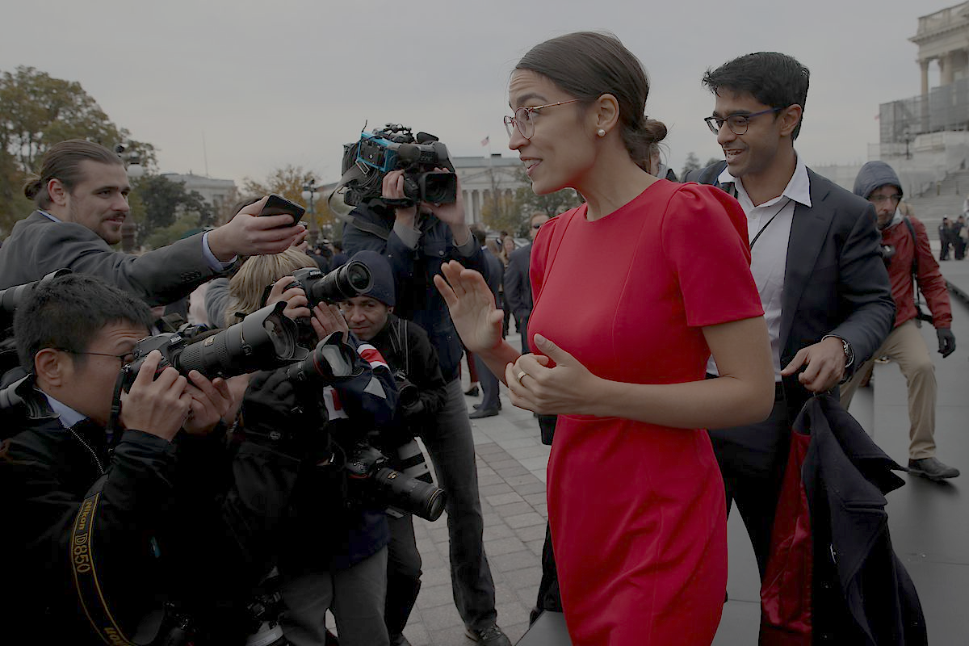
INTERNSHIPS
Undocumented Voice Project, Arizona State University, Tempe, Arizona
Latino Murals of Pilsen, University of Notre Dame, South Bend, Indiana and Chicago, Illinois
Research assistant, Washington State University, Pullman, Washington
Editorial Assistant, Radical History Review and History of American Sexuality, South Bend, Indiana
Legal intern, Social Justice Collaborative, Oakland, California
Research assistant, National Endowment for Democracy, Washington, DC
Intern to coordinator, International Positions, Dutch Ministry of Foreign Affairs, Den Haag

Slide 6
WHAT’S SPECIAL ABOUT AMERICAN
STUDIES?
  The way we teach (and you learn) follows a liberal arts model that emphasizes learner autonomy and interdisciplinary argument
  We are interested in the complicated relationship between politics and culture in the U.S. and beyond.
  We do not believe that culture and politics can be easily separated from one another. Politics are cultural and culture is political.
Notes:
UvA: it’s within the history department (ranked 55 world university)
Radboud: It’s within the English department (ranked 101 world university)
Leiden
We’re #66!

Slide 7

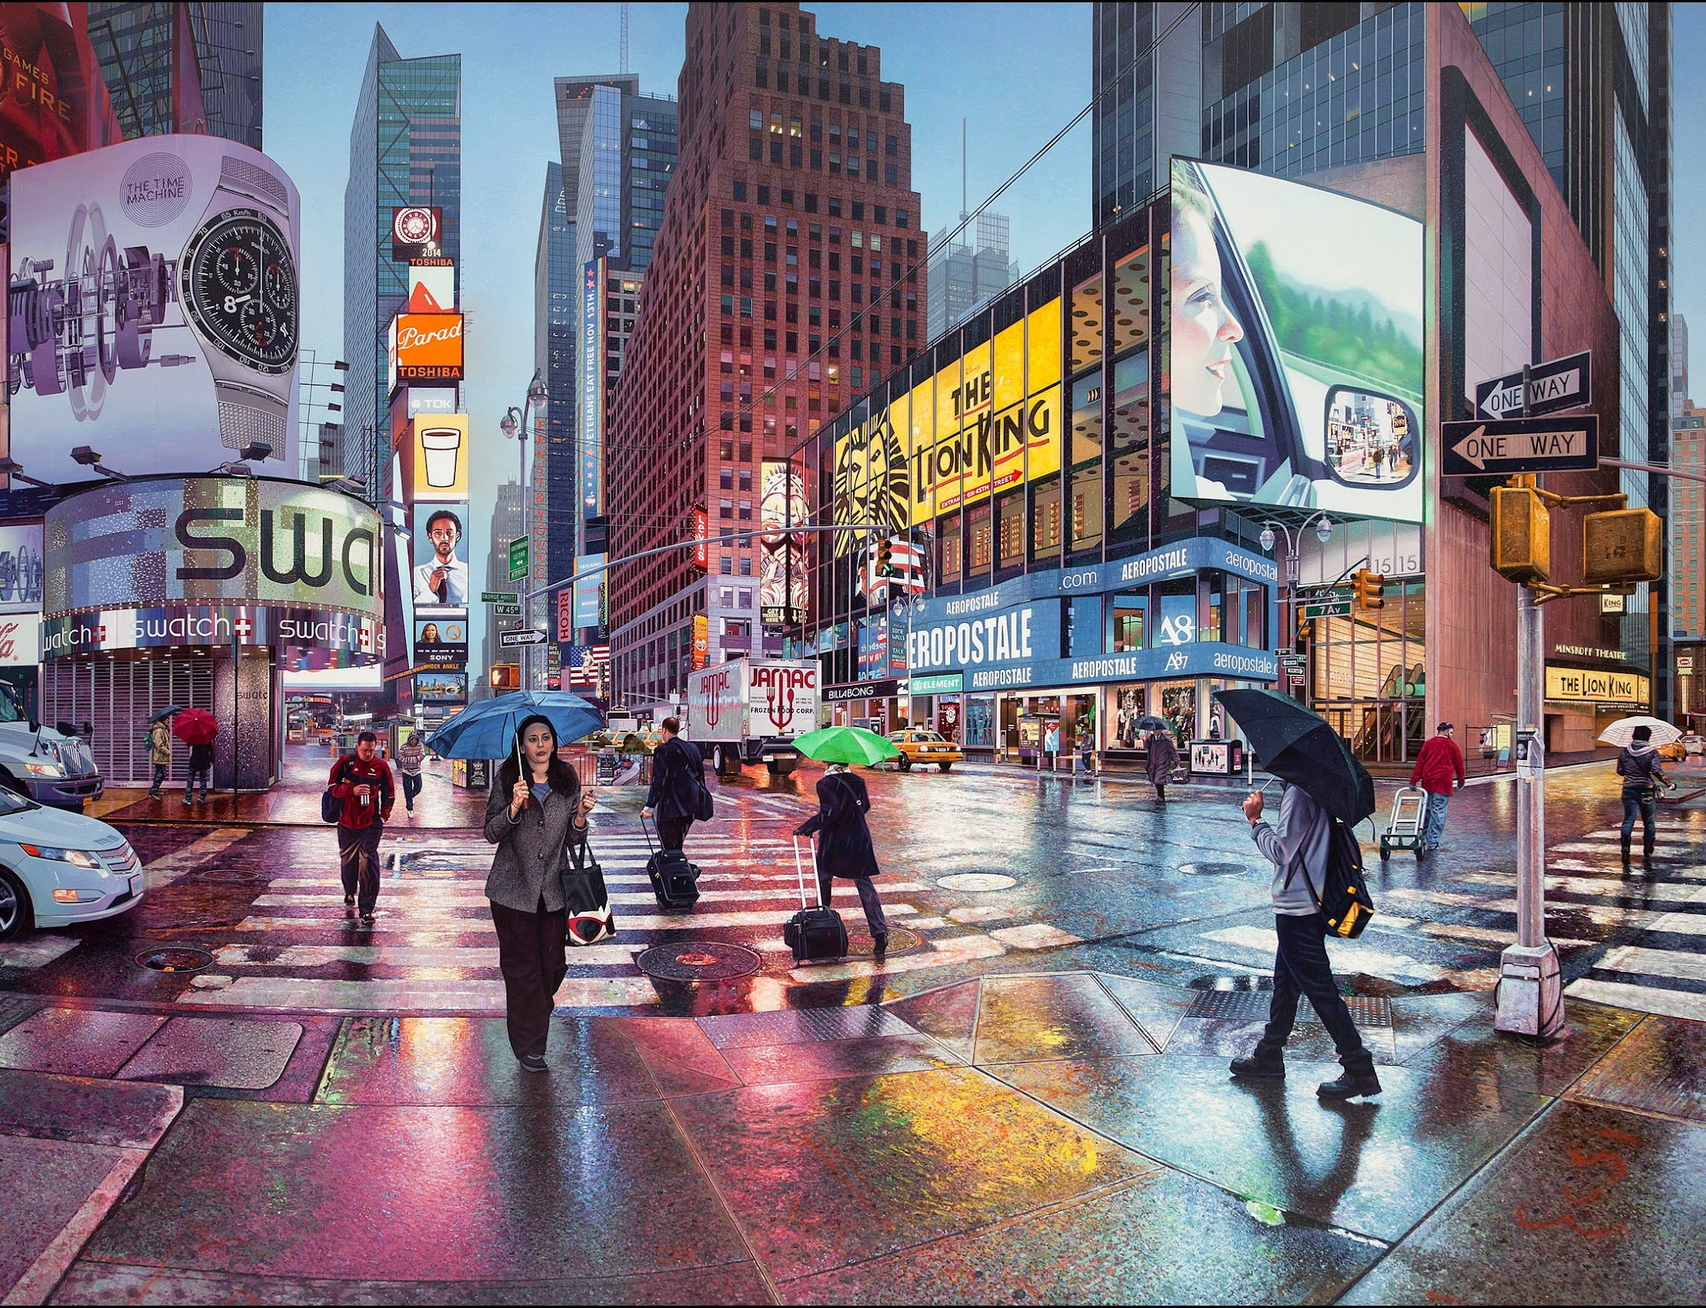
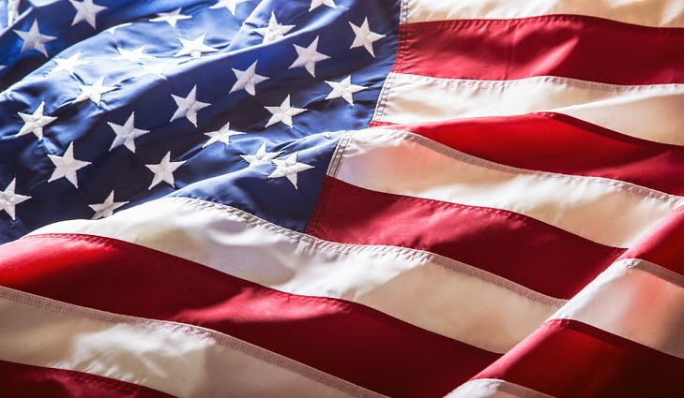
Semester 1
Domestic Cultures of U.S. Imperialism (Dr Schnepf)
The American Revolution Today (Dr Thompson)
History and Methods of American Studies (Dr Jelfs and Dr Roberts)
Semester 2
Writing for the Real World or study abroad or internship (Dr Olthof and Dr Zwiers)
MA dissertation

Slide 8
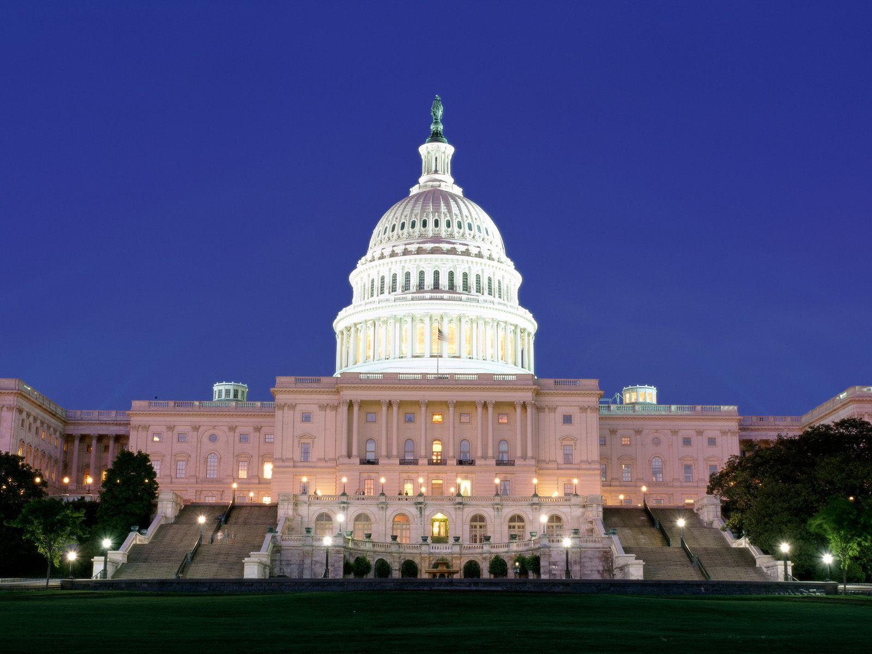
AMERICAN STUDIES
STUDY
ABROAD
University of North Carolina,
Chapel Hill
St. Louis University
Notes:
Students interested in journalism may consider using their
proficiency in US political and cultural affairs to work as correspondents or
reporters for international or US media outlets.
Interested in marketing or international business? Then consider utilizing your knowledge of U.S. economic,
cultural and commercial policies and practices by assisting U.S. and European companies seeking to
expand into the Dutch, European, and U.S. markets.
If you would rather work in the cultural domain, consider working in a museum or arts
organization or utilizing your cross-cultural experiences and English skills to work in the travel industry
by organizing and leading guided trips.
Your subject-matter expertise in U.S. socio-political affairs and proficient English skills
are relevant transferrable skills for work in the public sector. Consider working for an NGO or
governmental entity, in positions ranging from Media and Communication Coordinators to Information Officers.
Working at institutions of secondary and higher education is another great option
as a number of our graduates have taught English or History. Several American Studies
graduates also wish to continue their studies by completing their Master's degree and pursuing a
PhD degree, either in The Netherlands, the UK or the US.

Slide 9
AMERICAN
STUDIES
FACULTY MINOR (PRE-MASTER)
30 CREDITS
USUALLY FALL SEMESTER

Slide 10
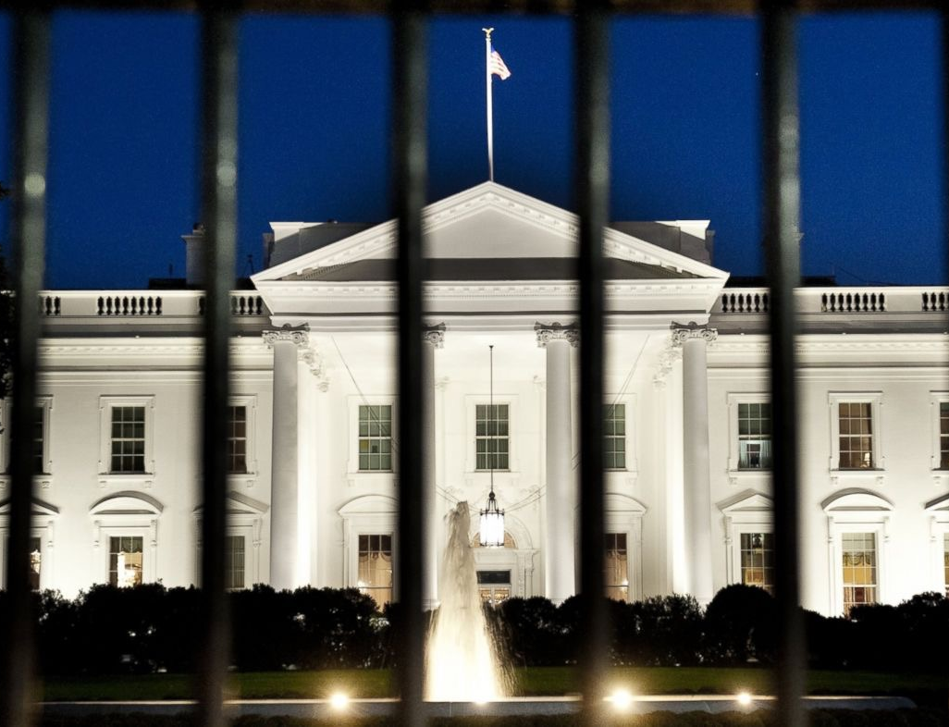
AMERICAN
STUDIES
GET CONNECTED
Questions?
Need more information?
Info-americanstudies@rug.nl
rug.nl/masters/american-studies

